Slide 1

SECURITY ARCHITECTURE
LECTURE III (Application Signing)
Speaker: Dimitrios Valsamaras | @Ch0pin
https://www.linkedin.com/in/valsamaras/

Slide 2

Application Signing - Goal
Provide same origin policy for apps updates originate from the same developer
The validation is based on well known cryptographic primitives
Every application that is run on the Android platform must be signed by the developer
It is the first step to place an application to its Sandbox as the certificate defines which user ID is associated with which application
There is no Central Authority, Android does not perform CA verification for application certificates (Self Signed x.509 Certificate no PKI) .
Package update requires the same certificate
Applications are also able to declare security permissions
at the Signature protection level
When two or more applications are signed with the same
certificate they can share the same user id via the
android:sharedUserId*
*Shared user IDs cause non-deterministic behavior within the package manager. As such, its use is strongly discouraged and may be removed in a future version of Android

Slide 3
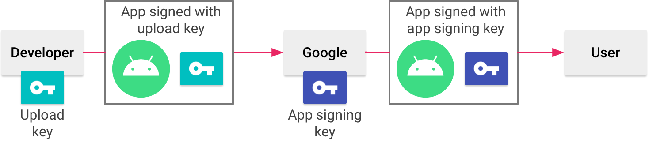
Application Signing
Off - Google Play Market: The developer manages the APK signing key and is in charge for it. In case the key has been lost, it cannot be recovered.
Play App Signing: Google manages and protects the app's signing keys uses them to sign the APKs for distribution
if the key gets lost or compromised, the developer can contact Google to revoke the old one
Application distribution must take place only through Google Play
+
-
Figure: https://developer.android.com/studio/publish/app-signing

Slide 4
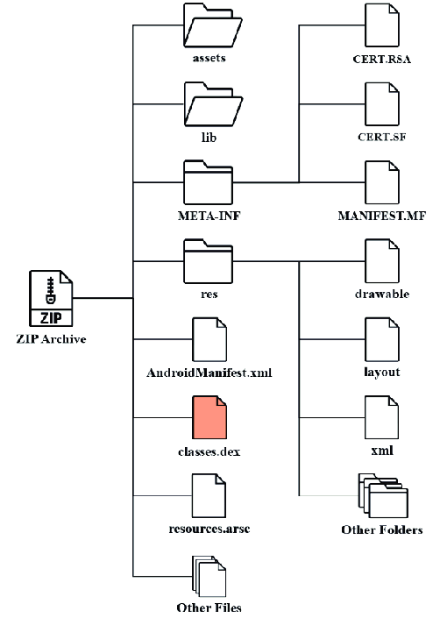
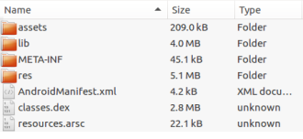
APK structure
$java -jar apktool d test.apk -o folder/

Slide 5

Signature Schemes Version 1
Version 1:
JAR signing: Each file is signed with an unique signature, while it doesn’t protect some parts of the APK, such as ZIP metadata.
CVE-2017–13156
As and apk file is a zip archive the JAR signature scheme takes into account only the zip entries
Exploits the the possibility to add extra bytes to APK files and to DEX files.
Impact: An attacker can prepend a malicious DEX file into an APK file without affecting its signature.
Janus affects Android devices (Android 5.0 < 8.1)
when signed with v1 signature scheme.

Slide 6
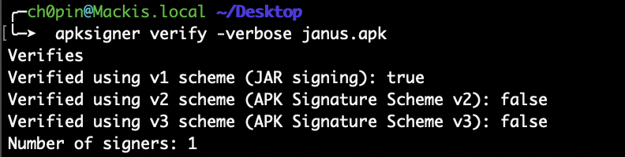
Janus vulnerability
Download the vulnerable apk https://apkgit.com/app/h5-browser/org.noear.h5
2. Use https://github.com/V-E-O/PoC/blob/master/CVE-2017-13156/janus.py to “inject” a malicious DEX file:
$python janus.py classes.dex janus.apk update.apk
Run on Android 5.0 < 8.1

Slide 7
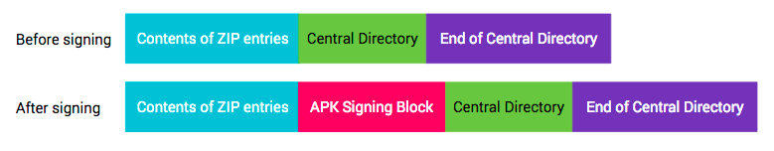
Signature Schemes Version 2 & 3
Signing using APK Signature Scheme v2 inserts an APK Signing Block into the APK file immediately before the ZIP Central Directory section:
Signer’s identity (as an x509 certificate chain)
Signature: <algorithm, digest, signature>
Additional attributes as <key, value> pairs

Slide 8
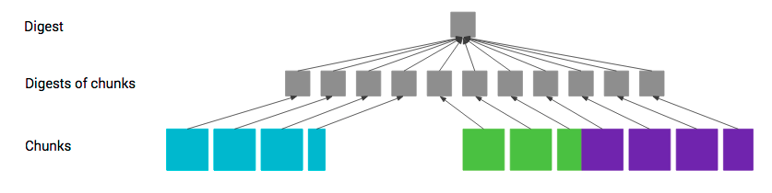
Signature Schemes Version 2 & 3
Digest of 1,3 and 4 sections of the apk is computed as follows
2 level Merkle Tree
c2, c3, c4 …
cn-2, cn-1, cn
c1 (1MB)

Slide 9
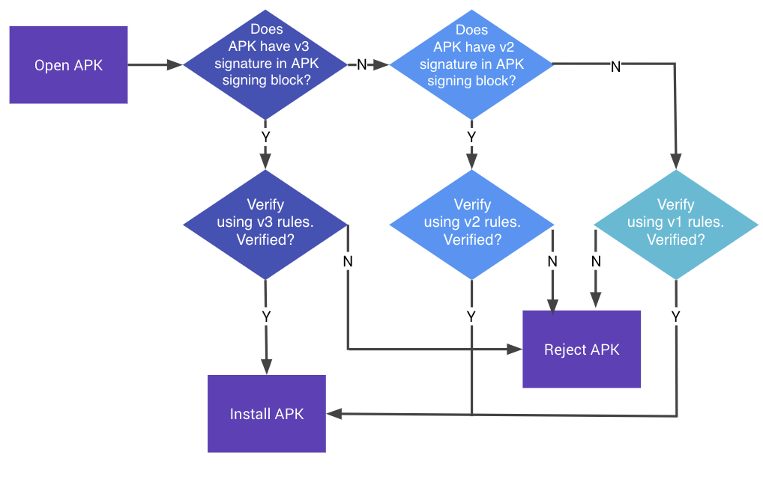
Signature Schemes Version 2 & 3

Slide 10
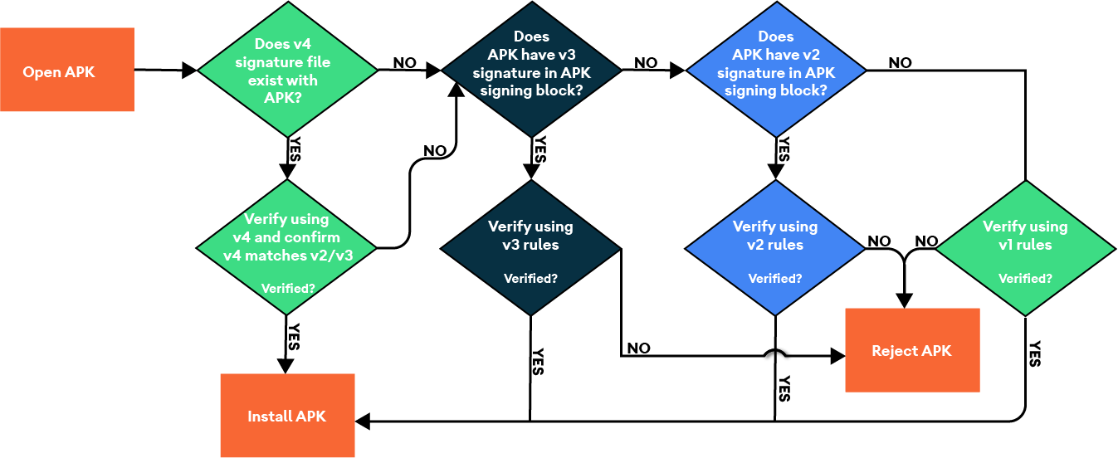
APK Signature Scheme v4
Android 11 supports a streaming-compatible signing scheme with the APK Signature Scheme v4. The v4 signature is based on the Merkle hash tree calculated over all bytes of the APK.

Slide 11
Signing an APK
Step 1: Generate Keystore
Generate a keystore once and use it to sign your unsigned apk. Use the keytool provided by the JDK found in %JAVA_HOME%/bin/
$keytool -genkey -v -keystore my.keystore -keyalg RSA -keysize 2048 -validity 10000 -alias app
Step 2: zipalign
$zipalign -p 4 in.apk out.apk
Step 3: Sign apk
$apksigner sign --ks my.keystore my-app.apk --ks-key-alias alias_name

Slide 12
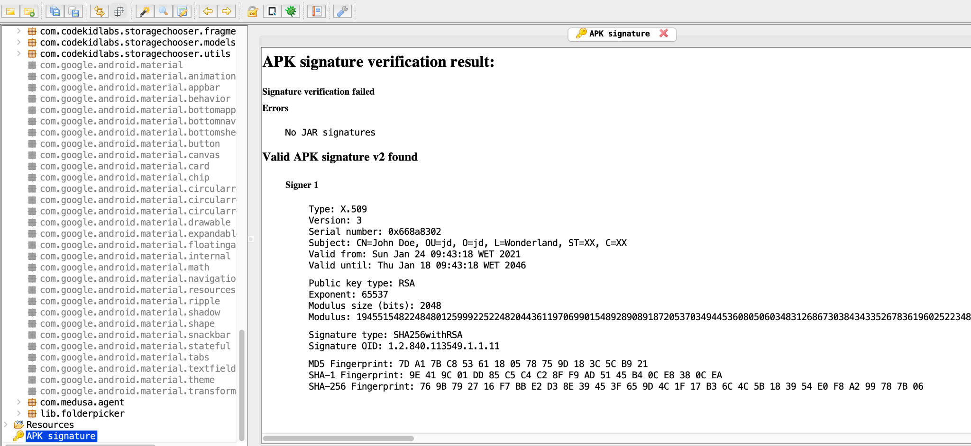
Viewing the signature
Install jadx

Slide 13
References
https://source.android.com/security/apksigning
https://developer.android.com/studio/publish/app-signing
https://docs.oracle.com/javase/8/docs/technotes/guides/jar/jar.html#Signed_JAR_File
https://en.wikipedia.org/wiki/Merkle_tree
https://developer.android.com/studio/command-line/apksigner

